Slide 1
Maintaining your emotional well-being in uncertain times
Carolyn Lamparella, EdS, LPC
610-433-8550
800-327-8878
www.preferredeap.org

Slide 4
COVID-19 has caused perpetual hypervigilance

Slide 6
Coping with Loss
Acceptance
Denial
Stages of Grief
Sadness
Anger
Bargaining

Slide 8
Source: D.A. Bangasser and R.J. Valentino/Front. In Neuroendocrinology. 2014
Disorder | Female % | Male %
Panic | 6.2 | 3.1
Generalized anxiety | 7.1 | 4.2
Any anxiety disorder | 36.4 | 25.4
PTSD | 9.7 | 3.6
Major depression | 20.2 | 13.2
Any affective disorder | 24.4 | 17.5
Alcohol abuse | 7.5 | 19.6
Drug abuse | 4.8 | 11.6
Migraine | 18.2 | 6.5
Insomnia | 12.9 | 6.2
Irritable bowel syndrome | 14.5 | 7.7

Slide 9
Vulnerability
The emotion we experience during times of uncertainty, risk and emotional exposure

Slide 10
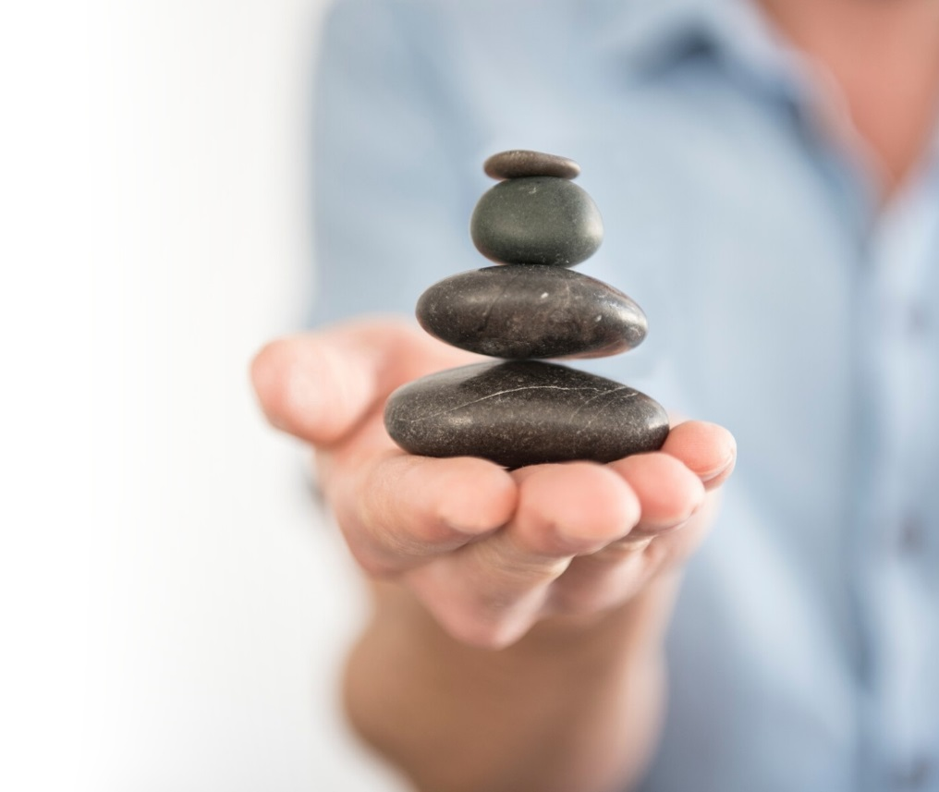
Restoring Balance

Slide 11
Be Intentional

Slide 12
Pillars of Well-Being
Sleep
Emotional Regulation
Mindfulness
Movement and breathing
Nutrition
Relationships
Spiritual
Laughter

Slide 13
New Habits
Make it easy
Make it obvious
Make it attractive
Make it satisfying

Slide 14
Sleep
Maintain the same sleep schedule
Make your room quiet and dark
Meditate or breathing exercises before bed
Avoid caffeine and alcohol before bed
Don’t lie in bed awake or look at the clock
Exercise early in the day
Exposure to sunlight early in the day
Have wind down routine
Use your bed for sleep only
Make your bedroom cold
Take a hot shower or bath 1 hour before bed

Slide 15
Mindfulness

Slide 16
Be Present
5 things you see
4 things you touch
3 things you hear
2 things you smell
1 thing you taste

Slide 17
STOP
Stop
Take a Breath
Observe the sensations in your body
Proceed with self-compassion

Slide 18
3 Minute Mindfulness
http://www.valleypreferred.com/media/387624/ three_minute_breathing.mp3

Slide 19
1728 W. Jonathan St
Allentown, PA 18104
www.PreferredEAP.org
610-433-8550
800-327-8878

Slide 20
Resources
Yoga is helpful for stress reduction as well as flexibility: https://www.youtube.com/user/yogawithadriene
Try this 3-minute mindfulness exercise from LVHN: http://www.valleypreferred.com/media/387624/ three_minute_breathing.mp3
Are we actually feeling grief over a changing world? https://hbr.org/2020/03/that-discomfort-youre-feeling-is-grief

Slide 21
Resources
On managing stress, from Lehigh Valley Health Network: https://news.lvhn.org/managing-stress-during-the-covid-19-outbreak/
Learn how to overcome worry, from Psychology Tools: https://www.psychologytools.com/assets/covid-19/guide_to_living_with_worry_and_anxiety_amidst_global_uncertainty_en-us.pdf
Many of us are working remotely. This can come with a new set of challenges. Here are great tips from NPR: https://www.npr.org/2020/03/15/815549926/8-tips-to-make-working-from-home-work-for-you
Combine mindfulness and walking to help de-stress. https://www.mindful.org/daily-mindful-walking-practice/

