Slide 1
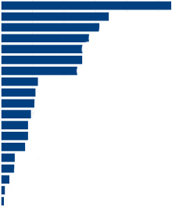
Our mission is to ensure an employer demand-driven world class workforce system aligned with economic development, education and the community
Workforce Snapshot
Targeted Industry Sectors
Manufacturing | Healthcare & Social Assistance
Finance & Insurance | Transportation & Warehousing
Professional, Scientific, and Technical Services
Education System
School Districts | 17
Career and Technical Schools | 3
Community Colleges | 2
Colleges and Universities | 9
Workforce AGE (QWI, Qtr 2019)
14-18 | 3.1%
19-24 | 10.9%
25-34 | 21.5%
35-44 | 19.7%
45-54 | 20.1%
55-64 | 18.3%
65+ | 6.4%
Economy & Population
Gross Regional Product | $43.3B
Total Population | 674,232
Workforce RACE/ETHNICITY/Gender
White | 85.2%
Black/African American | 9.2%
Other | 1.7%
Hispanic/Latino | 14.9%
Female | 50.1%
Male | 49.9%
EMPLOYERS
Establishments | 15,629
Average Employees per Establishment | 22
Average Occupational Earnings per Hour | $23.22
Workforce COMMUTING (ON THE MAP - 2017)
95,868 Commute Out, Live Inside
93,048 Commute In, Live Outside
170,044 Work and Live in LV
Local Area Unemployment Statistics (DEC 2020)
Labor Force | 347,500
Employed | 324,900
Unemployed | 22,600
Unemployment Rate | LV 6.5% | PA 6.7% | U.S. 6.3%
Mix of Industry Employment for Lehigh Valley
(Quarterly Census Employment and Wages, 2019 Annual Averages )
Health Care and Social Assistance 59,282 (18.9%) Manufacturing 34,455 (11.0%) Retail Trade 32,593 (10.4%) Transportation and Warehousing 31,795 (10.1%) Accommodation and Food Services 26,015 (8.3%) Educational Services 25,379 (8.1%) Administrative and Waste Services 21,419 (6.8%) Wholesale Trade 12,181 (3.9%) Professional and Technical Services 11,901 (3.8%) Construction 11,174 (3.6%) Other Services, Ex. Public Admin. 8,996 (2.9%) Finance and Insurance 8,851 (2.8%) Public Administration 7,904 (2.5%) Management of Co. & enterprises 7,618 (2.4%) Arts, Entertainment, Recreation 5,636 (1.8%) Information 3,801 (1.2%) Real Estate and Rental Leasing 2,930 (0.9%) Utilities 1,351 (0.4%) Not Disclosed 619 (0.2%)
TOP OCCUPATIONS (DEC 2020)
Laborers/Freight, Stock, Material Movers, Hand
Registered Nurses
Retail Salesperson
Heavy and Tractor-Trailer Truck Drivers
Customer Service Representatives
Online job postings
Dec. 2020 | 5,427
Dec. 2019 | 6,530
Workforce Education Attainment Quarterly Workforce Indicators (QWI, 3rd QTR 2019)
Less-than-High School | 10.8%
High School/GED | 24.8%
Some College or Associate Degree | 27.0%
Bachelor’s Degree or Advance Degree | 23.4%
Educational Attainment not Available (workers aged 24 or younger) | 14.0%
Sources: Bureau of Labor Statistics (BLS), U.S. Census, PA Center for Workforce Information & Analysis (CWIA)
1

Slide 2
Job and Labor Market Data
Unemployment Rates
United States 6.3% (published February 5)
Pennsylvania 6.7 % (published January 22)
Lehigh Valley 6.5 % (published February 2)
Unemployment Compensation Claims 17,300 Lehigh County and Northampton County Claims Based on Four-Week Average as of January 16, 2021
2

Slide 3
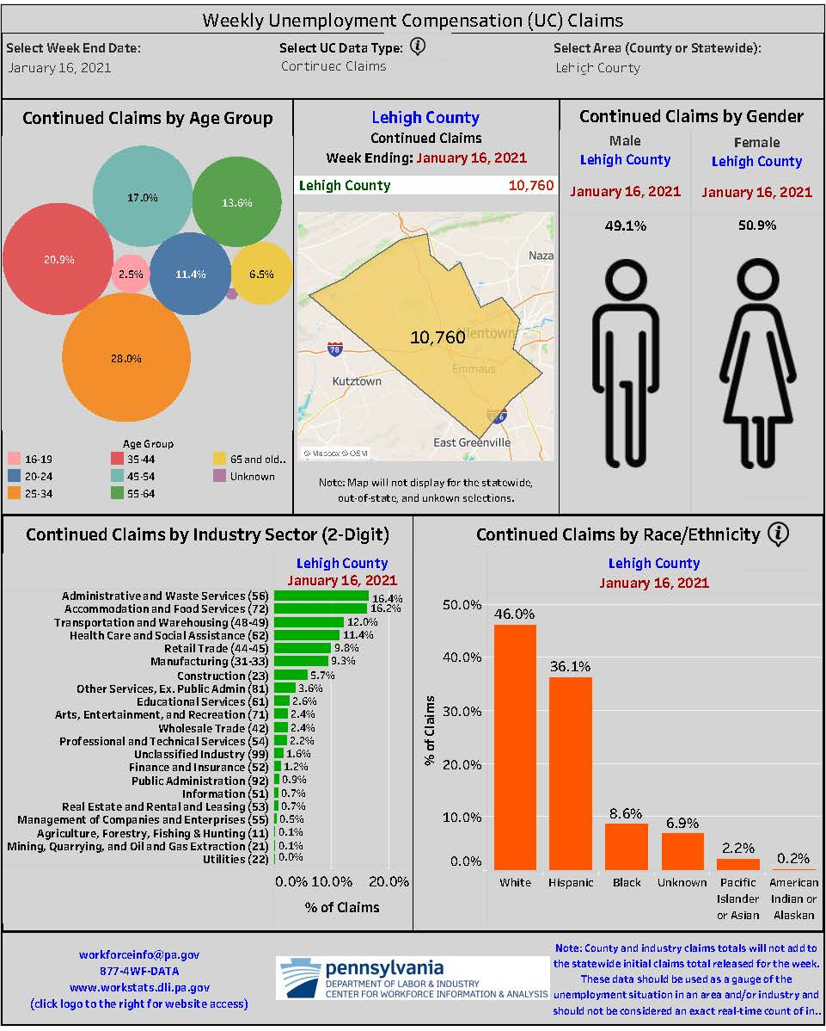
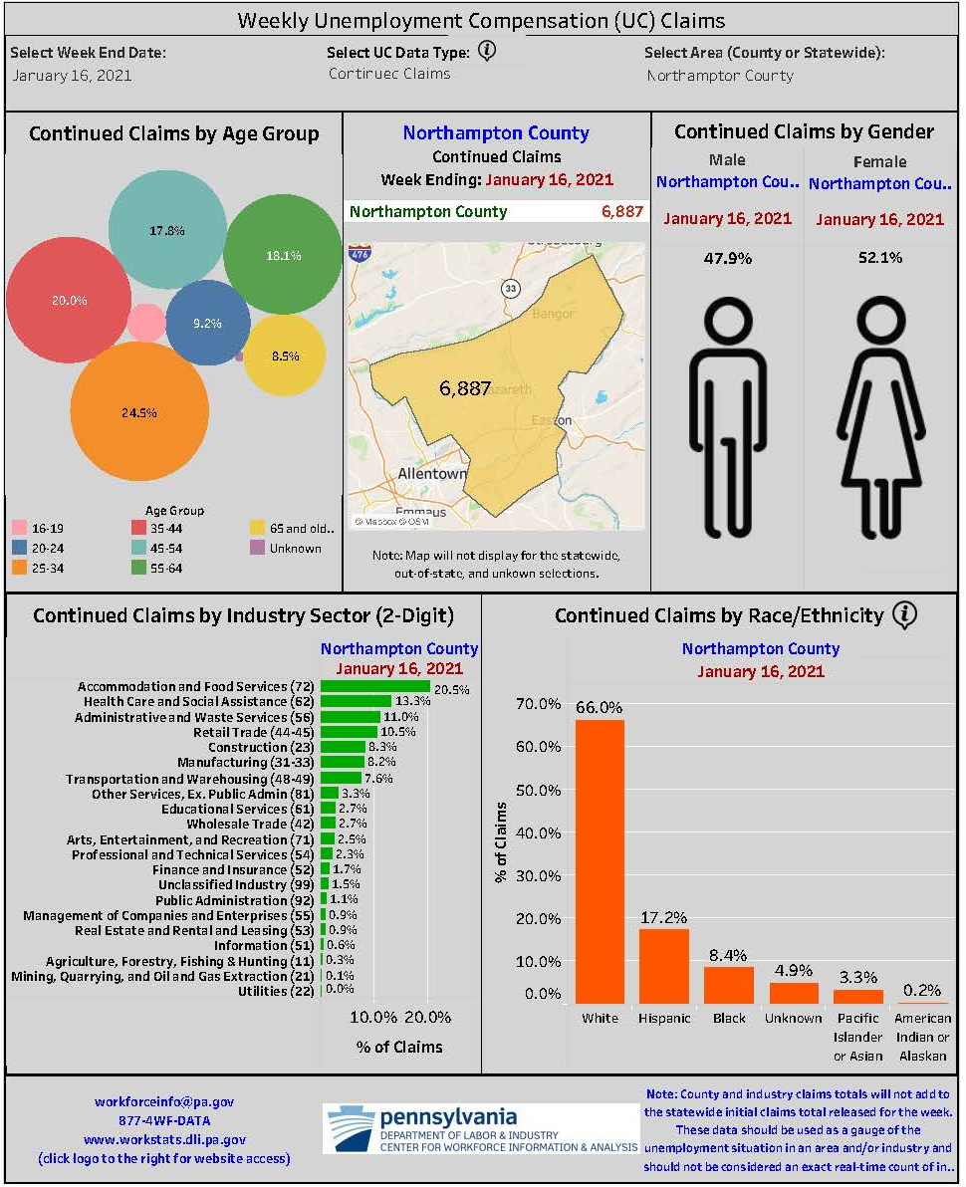
Unemployment Compensation Claims by County
3

Slide 4
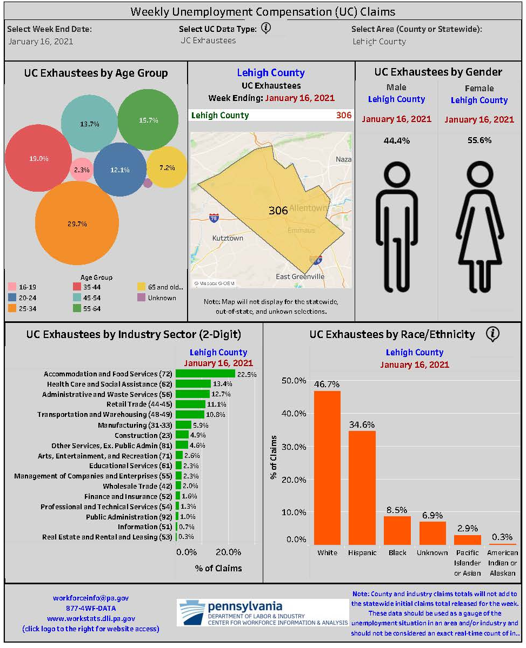
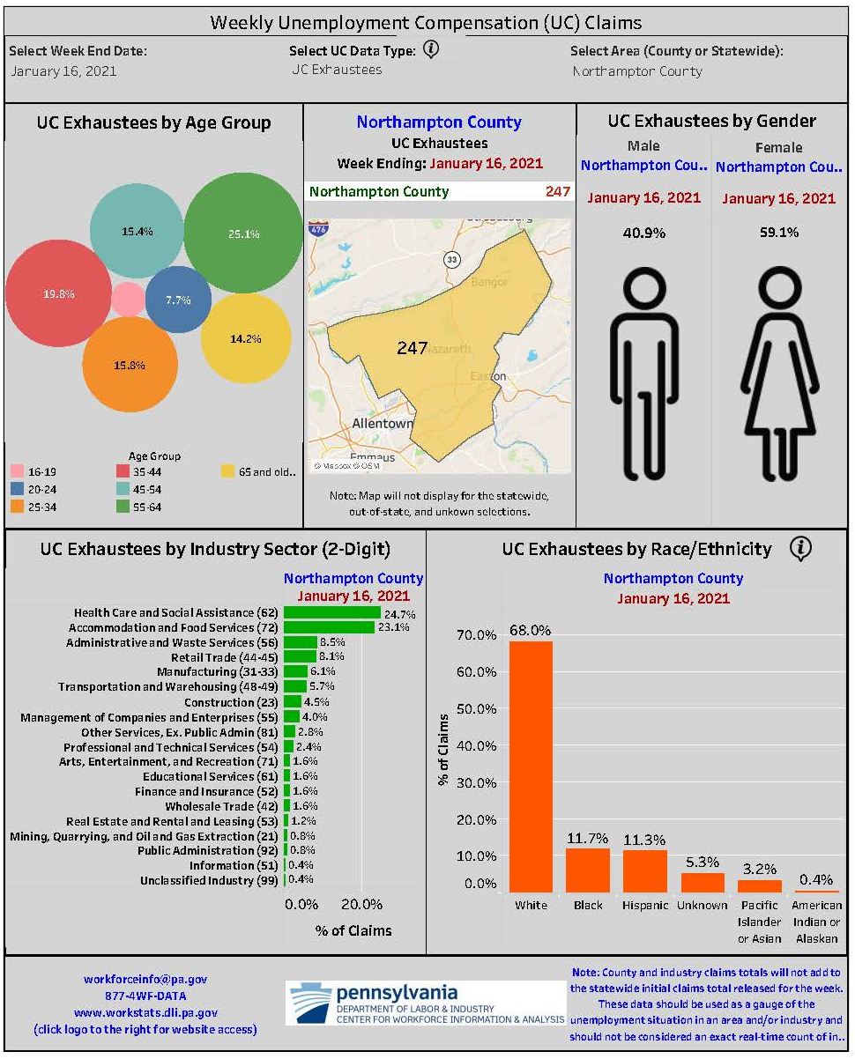
UC Exhaustees by County
4

Slide 5
Occupational Employment 2018 to 2028 Long Term Projections
Employment Outlook
Occupational Title | Estimated 2018 | Projected 2028 | Percent Change
Pennsylvania - Total all Occupations | 6,329,070 | 6,647,750 | 5.0%
Lehigh Valley - Total All Occupations | 331,680 | 356,580 | 7.5%
Healthcare Support | 11,330 | 13,450 | 18.7%
Personal Care and Service Workers | 16,430 | 18,860 | 14.8%
Healthcare Practitioners | 24,660 | 27,980 | 13.5%
Food Preparation and Serving Workers | 26,290 | 29,400 | 11.8%
Transportation and Material Moving Workers | 39,330 | 43,800 | 11.4%
Sales and Related Occupations | 28,670 | 29,220 | 1.9%
Production Workers | 23,380 | 23,530 | 0.6%
Office and Administrative Support | 51,200 | 51,010 | -0.4%
5

Slide 6
PA Center for Workforce Information and Analysis
Lehigh Valley Data – Lehigh and Northampton Counties
674,232 Total Population
347,500 Labor Force
324,900 Employed full and/or part-time
22,600 Unemployed (actively seeking employment)
17,300 Unemployment Compensation (4-week average)
162,158 Medical Assistance
1,554 Cash Assistance
91,991 Supplemental Nutrition Assistance Program
$25,750 Poverty Level Family of Four
98,317 K-12 students
7,464 High school graduates
5,518 College-bound students
6

